Slide 1
Round Table Discussion Ideas
Sean Park

Slide 2
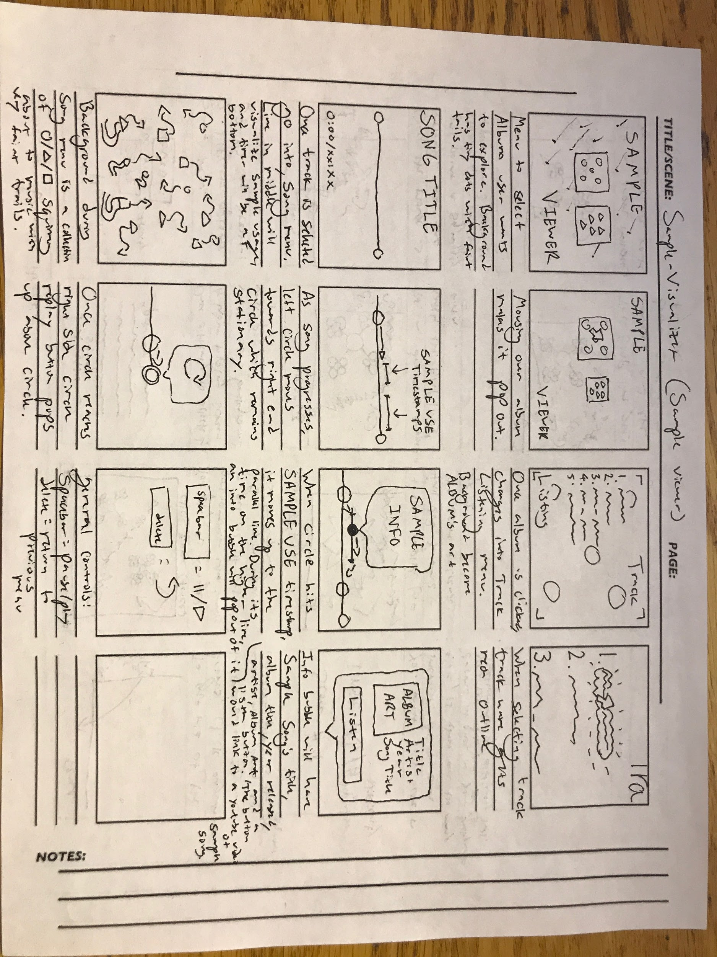
Sample Viewer

Slide 3
Title/Menu

Slide 4
Song Selection

Slide 5
Music Player/Visualizer

Slide 6
Backgrounds/Interaction

Slide 7
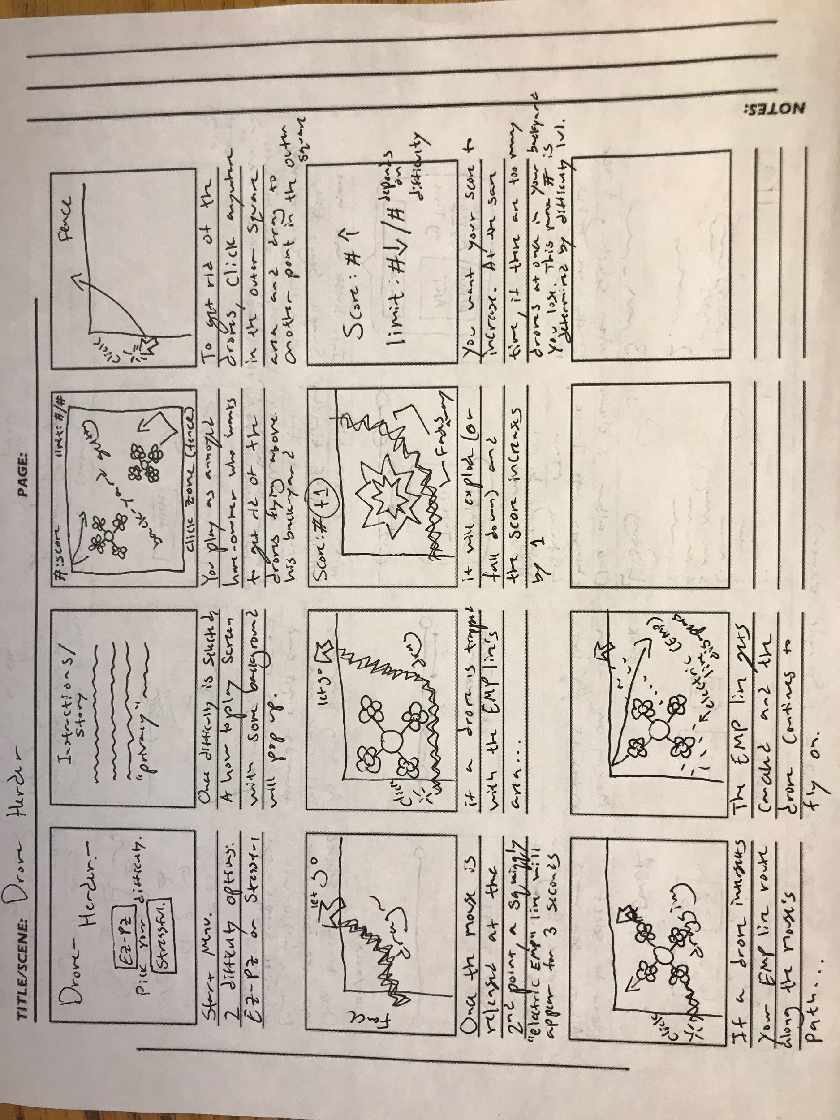
Drone Herder

Slide 8
Title/Menu

Slide 9
Setting/Game Screen

Slide 10
Interaction (win state)

Slide 11
Interaction (fail state)

Slide 12
Score/Difficulty Level

Slide 13
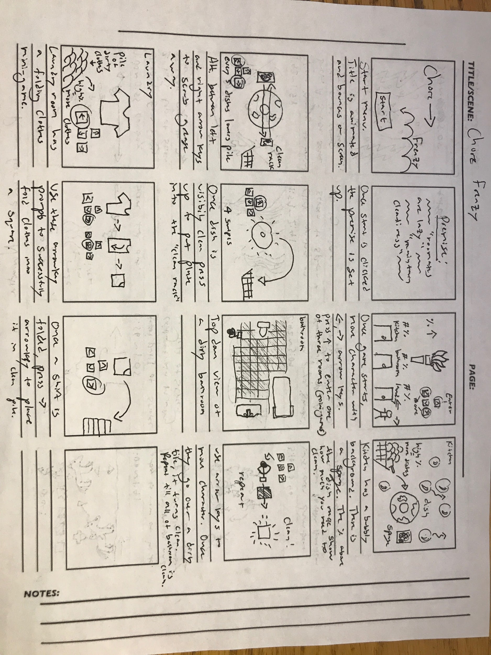
Dorm Chore Frenzy

Slide 14
Start Screen/Story

Slide 15
Mini Game Selection Screen

Slide 16
Kitchen Dish Wash Game

Slide 17
Bathroom Floor Scrub Game

Slide 18
Laundry Folding Game

Slide 19
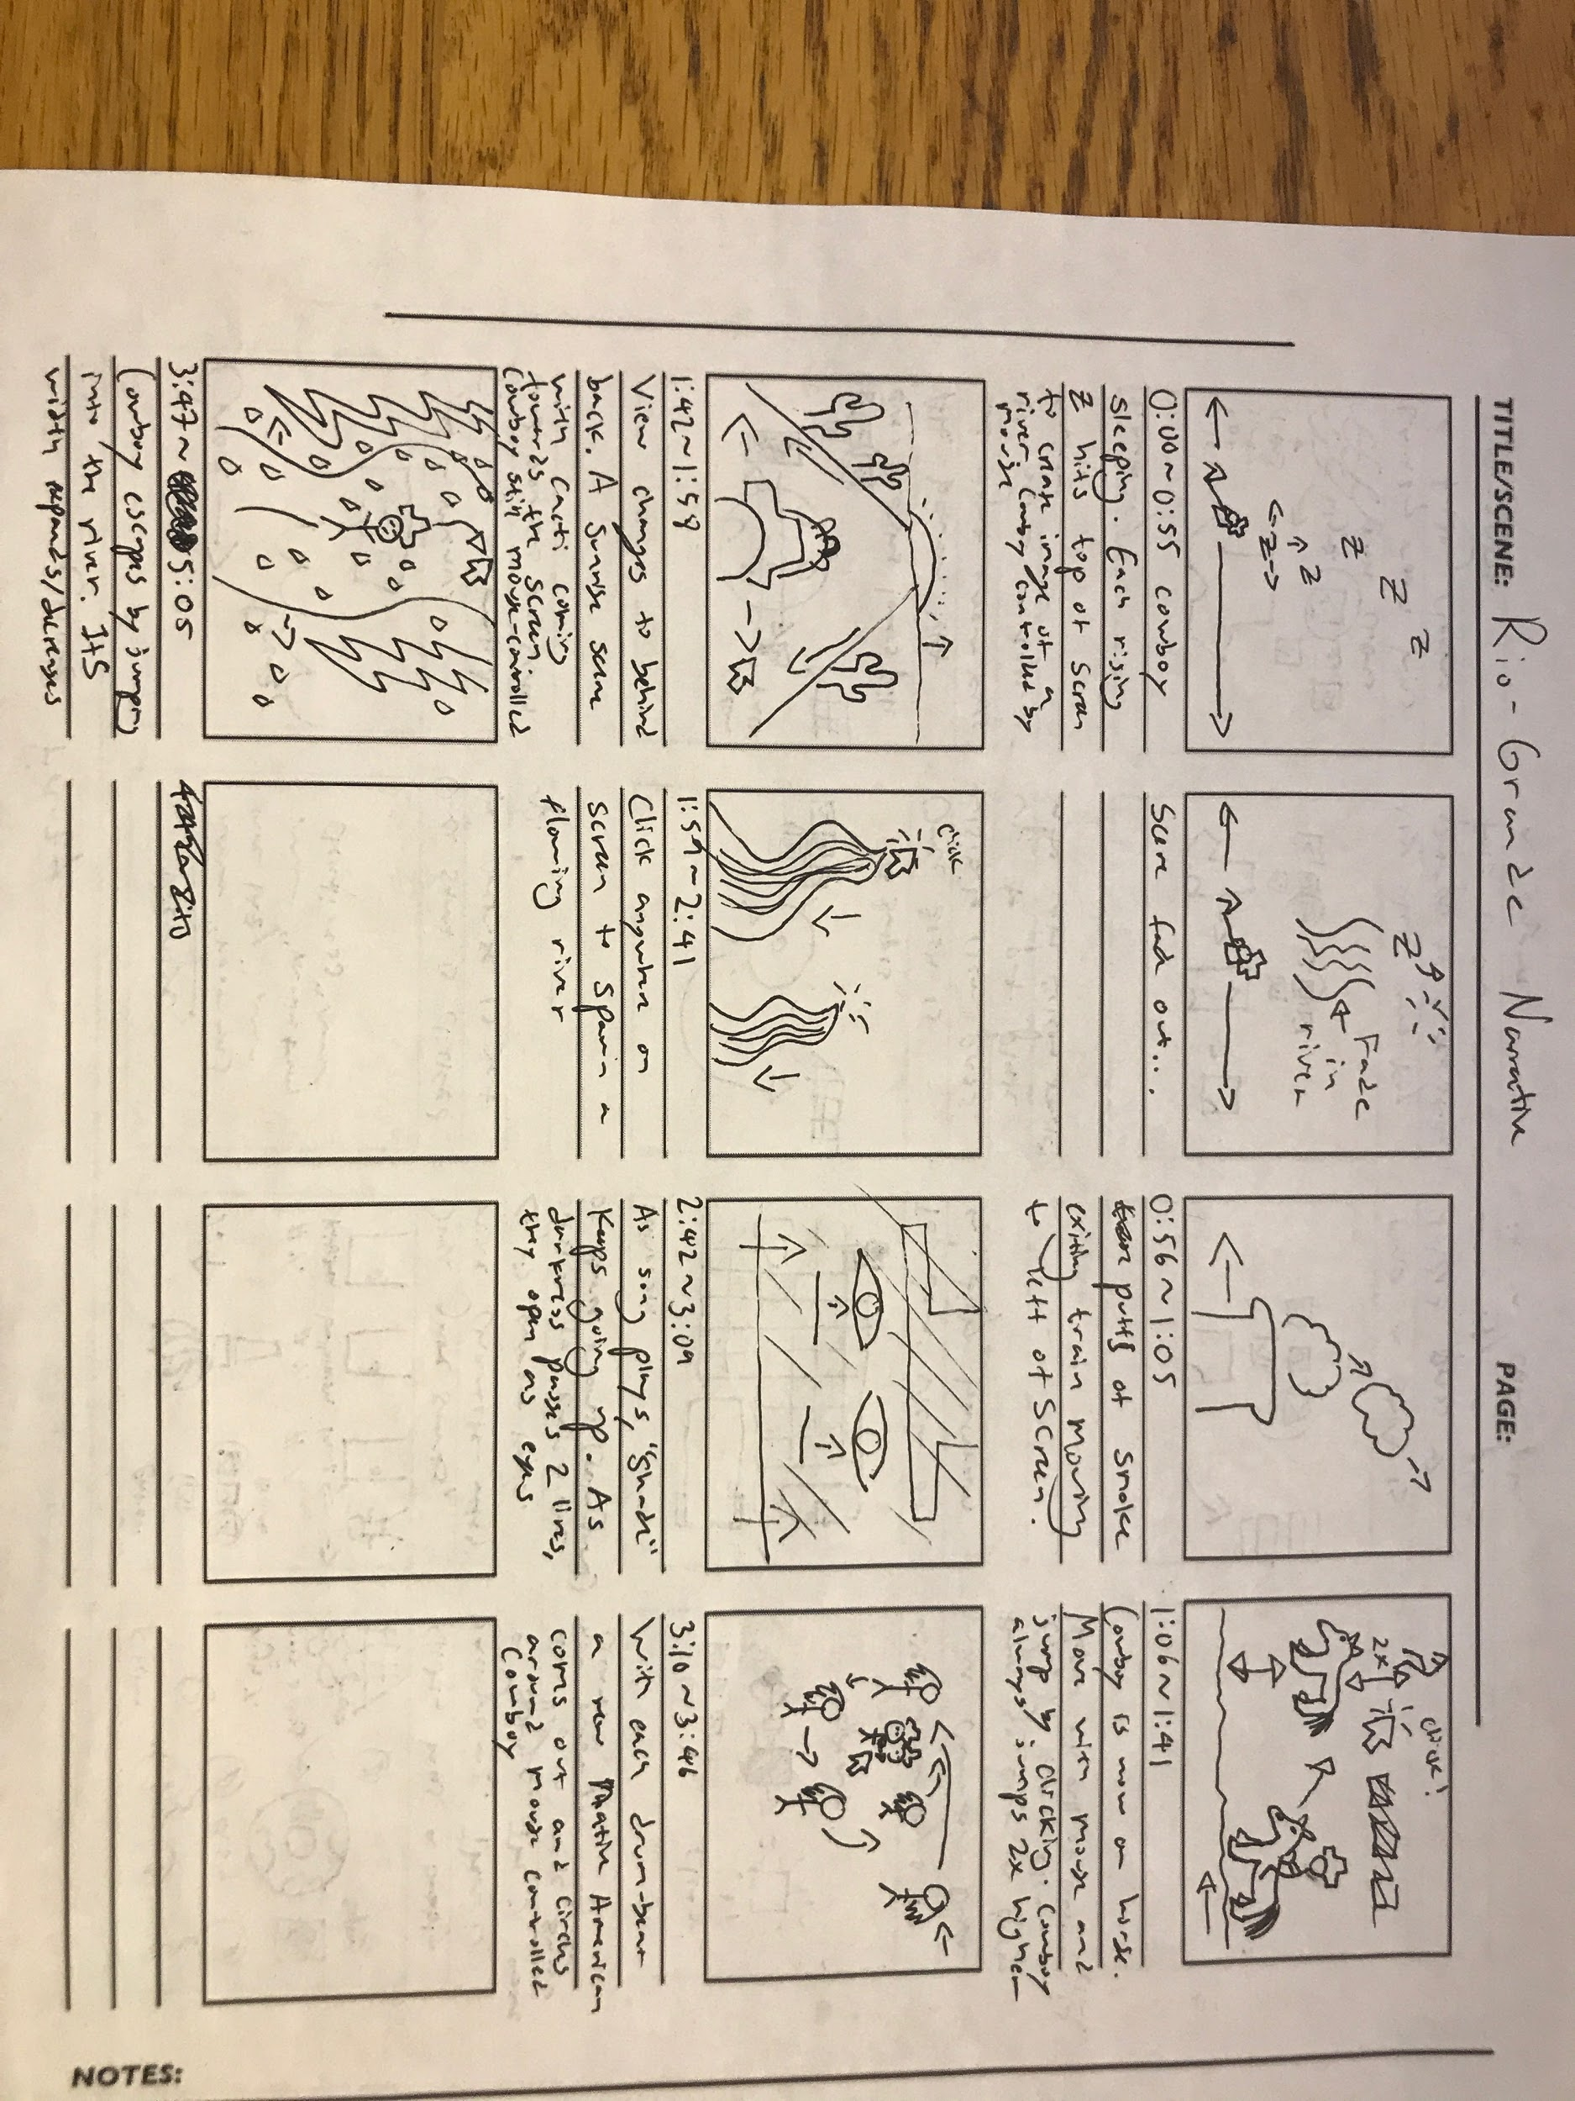
Rio Grande Narrative

Slide 20
Intro: Cowboy Dream Scene

Slide 21
Train Transition

Slide 22
Horse Riding Scene

Slide 23
Riding the Sunrise Scene

Slide 24
River Flow Interaction Scene

Slide 25
Falling Asleep Transition

Slide 26
Nightmare Scene

Slide 27
Exit Scene: River Riding Scene

